Slide 1
IEO – week 2

Slide 2
What we discussed
Basic Computer Architecture
Central processing unit
Graphical processing unit

Slide 3
This week
What is computer’s language?
Notes:
Applies to al electronic devices?
https://www.khanacademy.org/math/pre-algebra/applying-math-reasoning-topic/alternate-number-bases/v/number-systems-introduction

Slide 4
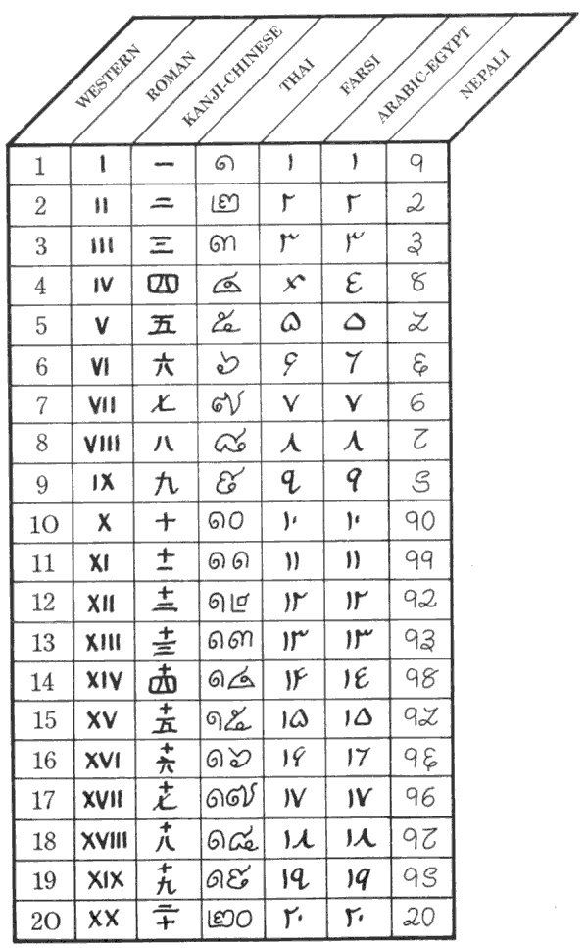
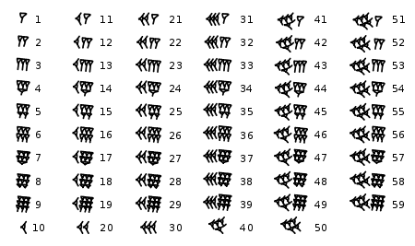
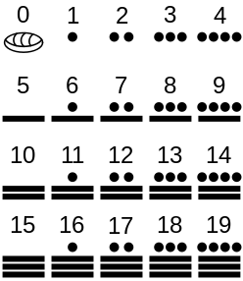
Numeral systems
How do we count?
What’s a number?
What’s a digit?
Notes:
Before talking about hwo a computer counts
We as humans count 1…9, 10…19…etc
One way to write is by talliying, but this becomes harder to read one we have writen alot of |
So we invented numbers. The number 2 is the same as ||
When we get to 9 and want to add another it doesnt fit in this single digit, so we write down a 1 and start counting from 0 again (10)
Looking at 10 we can say that 10 is a number and this 10 has two digits the 1 and the 0

Slide 5

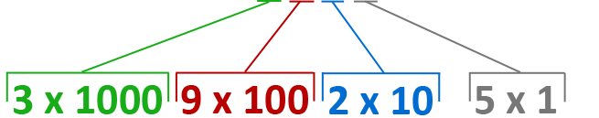
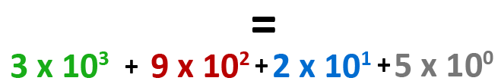
Decimal system
Day-to-day used numeral system
Notes:
Number 3125
Digit 3 means 3 1000
Digit 1 means 1 100
Digit 2 means 2 10
Digit 5 means 5 1
Another way is with 10 powers
-------------------------------------------------------

Slide 6
Decimal system
Digits: 0, 1, 2, 3, 4, 5, 6, 7, 8 & 9
Base: 10
Weight of a digit: 10 ^{P(osition)}
Range of values: 0 ~ (10 ^{n} - 1)
Notes:
P: position
N: number of digits
Available digits
Base 10
When we want to add 1 to 9 it doens’t fit so we have a carry over and start the digit a new -> 10
Weight is base 10 power position counting from 0 from the right to left
Range
Why we use base 10 in day-to-day. Dunno because perhaps most of us we have 10 fingers?
---------------------------------
Besides decimal we have more numeral systems. For example binary system

Slide 7

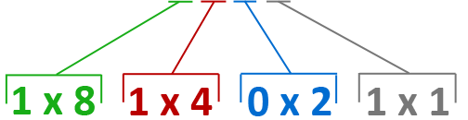

Binary system
IT related numeral system
Notes:
1 binary digit -> bit
Byte -> 8 bit

Slide 8
Binary system
Digits: 0 & 1
Base: 2
Weight of a digit: 2 ^{P(osition)}
Range of values: 0 ~ (2 ^{n} - 1)
Notes:
P: position
N: number of digits
1 binary digit -> bit
Byte -> 8 bit

Slide 9
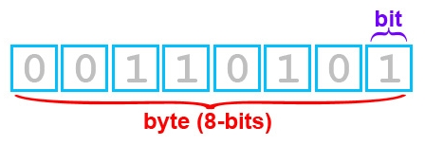
Binary system - Terminology
bit:1 binary digit
In (most) abbreviations: b=bit, B=byte
bps means: bits per second
Bps means: bytes per second
Notes:
Bps and Bps are used in connection speed

Slide 10
Binary system – ISO notation
ISO notation
kB = kiloByte = 1,000 Byte
MB = MegaByte = 1,000,000 Byte
GB = GigaByte = 1,000,000,000 Byte
TB = TeraByte = 1,000,000,000,000 Byte
Note: There is also IEC notation with binary prefixes (see Wikipedia)
Example:
KiB = KibiByte = 2¹⁰ Byte = 1,024 Byte (KiBi is short for “Kilo Binary”)

Slide 11

Why?
Computers (internally) use it
CPU, network, Colors, etc
Programming
C#: int variable (32 bits) -> Convert.toInt32();
Notes:
Now you can understand this joke
Storage works with 1 or 0 (binary) this is because a bit can have a charge (1) or uncharged (0).

Slide 12

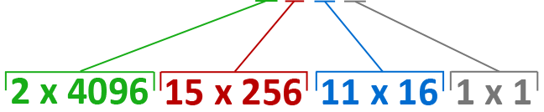
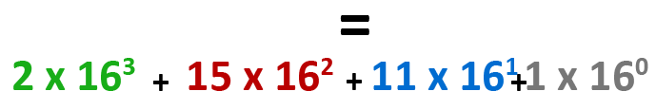
Hexadecimal system
IT related numeral system

Slide 13
Hexadecimal system
Digits: 0,1, 2, 3, 4, 5, 6, 7, 8, 9, A, B, C, D, E & F
Base: 16
Weight of a digit: 16 ^{P(osition)}
Range of values: 0 ~ (16 ^{n} - 1)
Notes:
P: position
N: number of digits
1 binary digit -> bit
Byte -> 8 bit

Slide 14
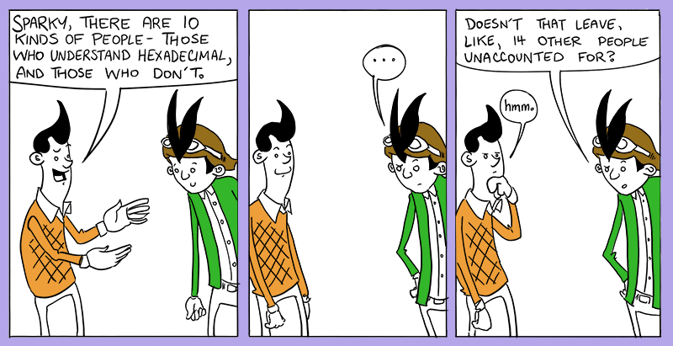
Why?
11011010110000110011100110100111
=
DAC339A7
Less writing
Easy conversion from/to binary
Used in CSS: color: #FFFFFF (white)

Slide 15
Different numeral systems
What does 10101 stand for?
Decimal
10101₁₀ (10) 10101 (decimal) 10101
Binary
10101₂ (2) 10101 (binary) 10101
Hexadecimal
10101₁₆ (16) 10101 (hex) 10101
Notes:
Using the calculator in windows on programmer mode we see that they are definitely not the same:
(10)10101 = (2)10011101110101 = (16)2775
(2)10101 = (10)21 = (16)15
(16)10101 = (2)10000000100000001 = (10)65793

Slide 16
Recap
Decimal
Base: 10
Digits: 0 ~ 9
Binary
Base: 2
Digits: 0 ~ 1
Hexadecimal
Base: 16
Digits: 0 ~ 9 & A ~ F
Weight factor
Base^{P(osition)}
Value range
0 ~ (base^{n} - 1)

Slide 17
Converting between numeral systems

Slide 18
Conversion guidelines
From another numeral system to decimal
Summation of all digit x weight factor
Decimal to another numeral system
Divide number by base until 0
Write down the remainder of each division

Slide 19
Binary to decimal
Summation of digits x 2 ^{P}
Binary number: 11101₂
Result: 29₁₀
1 |  | 1 |  | 1 |  | 0 |  | 1
1 x 2⁴ | + | 1 x 2³ | + | 1 x 2² | + | 0 x 2¹ | + | 1 x 2⁰
1 x 16 | + | 1 x 8 | + | 1 x 4 | + | 0 x 2 | + | 1 x 1
16 | + | 8 | + | 4 | + | 0 | + | 1

Slide 20
Decimal to binary
Divide by 2 & remainder of 2
Decimal number: 29₁₀
29 / 2 = 14, remainder 1
14 / 2 = 7, remainder 0
7 / 2 = 3, remainder 1
3 / 2 = 1, remainder 1
1 / 2 = 0, remainder 1
Result: 11101₂
Right
Left

Slide 21
Hexadecimal to decimal
Summation of digits x 16 ^{P}
Hexadecimal number: 1D₁₆
Result: 29₁₀
1 |  | D
1 x 16¹ | + | 13 x 16⁰
1 x 16 | + | 13 x 1
16 | + | 13

Slide 22
Decimal to hexadecimal
Divide by 16 & remainder of 16
Decimal number: 29₁₀
29 / 16 = 1, remainder 13 ( = D )
1 / 16 = 0, remainder 1 ( = 1 )
Result: 1D₁₆
Right
Left

Slide 23
Hexadecimal…
Hard to convert F02A₁₆ to decimal or 3568₁₀ to hexadecimal…
Conversion is easier with binary:
Decimal Binary Hexadecimal

Slide 24
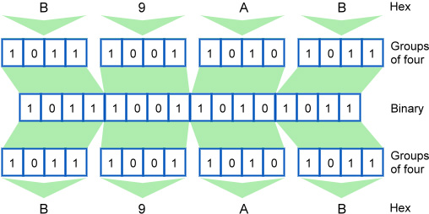
Binary & Hexadecimal
Group in to 4 bits
Hexadecimal
to
Binary
Binary
to
Hexadecimal

Slide 25
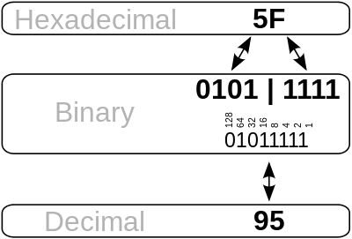
Recap
To decimal
Multiply each digit by weight factor
Add everything up
From decimal
Keep dividing number by base
Write down remainder

Slide 26
Exercise
Binary | Decimal | Hexadecimal
10 | 2 | 2
1010 | 10 | A
10000 | 16 | 10
10100010 | 162 | A2
1111011 | 123 | 7B
101110 | 46 | 2E

Slide 27
Answers
Binary | Decimal | Hexadecimal
10 | 2 | 2
1010 | 10 | A
10000 | 20 | 10
10100010 | 162 | A2
1111011 | 123 | 7B
101110 | 46 | 2E

Slide 28
Calculations in binary

Slide 29
Addition in binary
Decimal
18 + 996:
Binary
1011 + 111:
1 | 1 | 1
 |  | 1 | 8
 | 9 | 9 | 6 | +
1 | 0 | 1 | 4
1 | 1 | 1 | 1
 | 1 | 0 | 1 | 1
 |  | 1 | 1 | 1 | +
1 | 0 | 0 | 1 | 0
← Carry bits
← Carry bits

Slide 30
Exercise
Addition
100101₂ + 11101₂
1010101101₂ + 11111111₂

Slide 31
Answers
Addition
100101₂ + 11101₂ = 1000010₂
1010101101₂ + 11111111₂ = 1110101100₂

Slide 32
Multiplication in binary
Decimal
180 x 14:
Binary
1011 x 101:
 | 1 | 8 | 0
 |  | 1 | 4 | x
 | 7 | 2 | 0
1 | 8 | 0 |  | +
2 | 5 | 2 | 0
 |  | 1 | 0 | 1 | 1
 |  |  | 1 | 0 | 1 | x
 |  | 1 | 0 | 1 | 1
 | 0 | 0 | 0 | 0
1 | 0 | 1 | 1 |  |  | +
1 | 1 | 0 | 1 | 1 | 1

Slide 33
Exercise
Addition
100101₂ + 11101₂
1010101101₂ + 11111111₂
Multiplication
1101010₂ * 11010₂
111101010001₂ * 1000₂

Slide 34
Answers
Addition
100101₂ + 11101₂ = 1000010₂
1010101101₂ + 11111111₂ = 1101101100₂
Multiplication
11₂ * 10₂ = 110₂
11010₂ * 1110₂ = 101101100₂

Slide 35

Questions?

